Slide 1
LUMIRA – COMPOSE.
Milind Parab

Slide 2
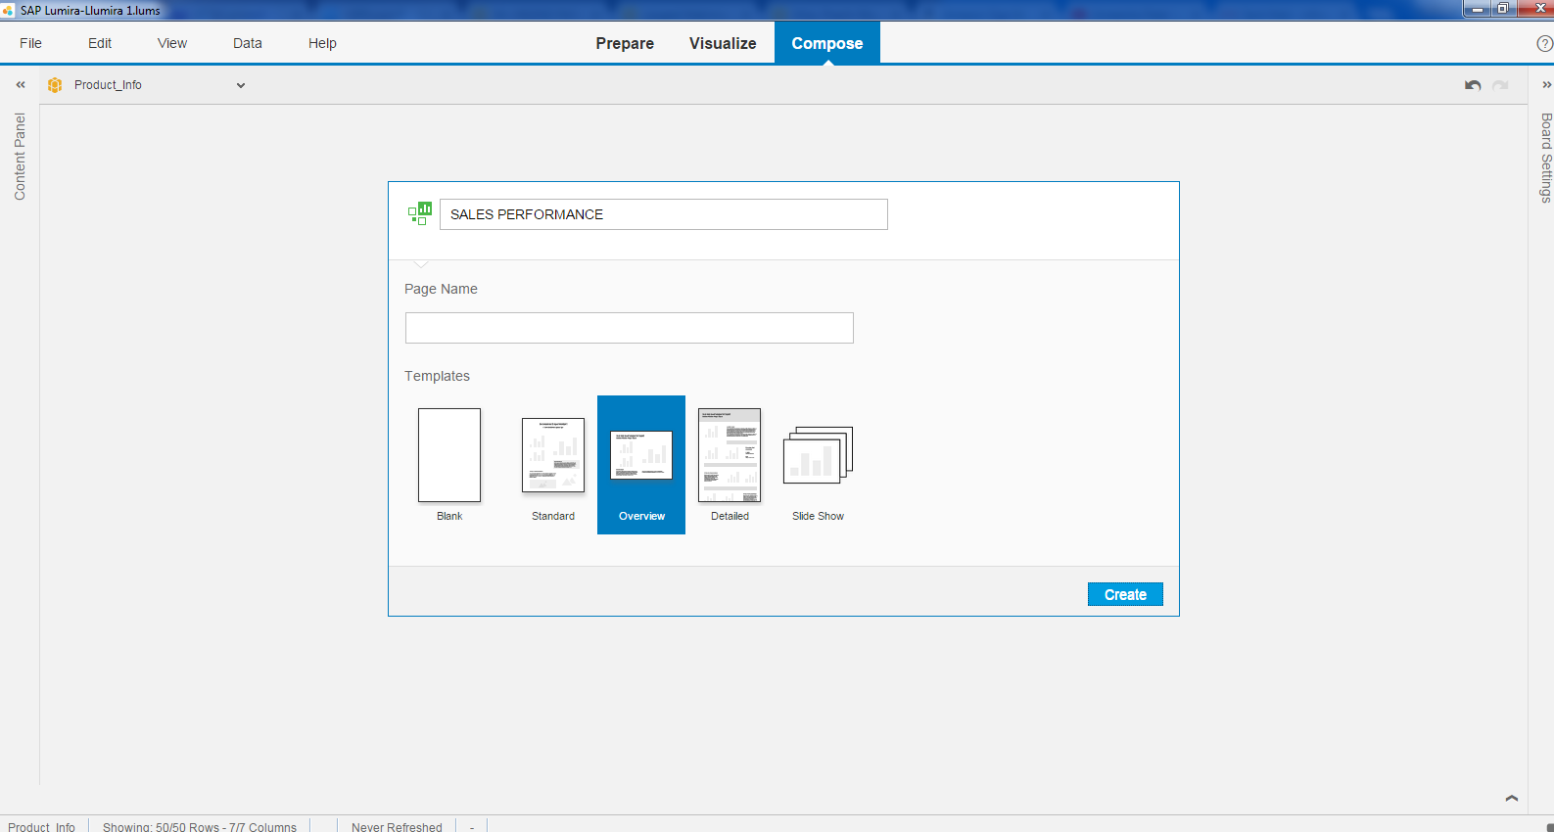
Click on Compose.

Slide 3
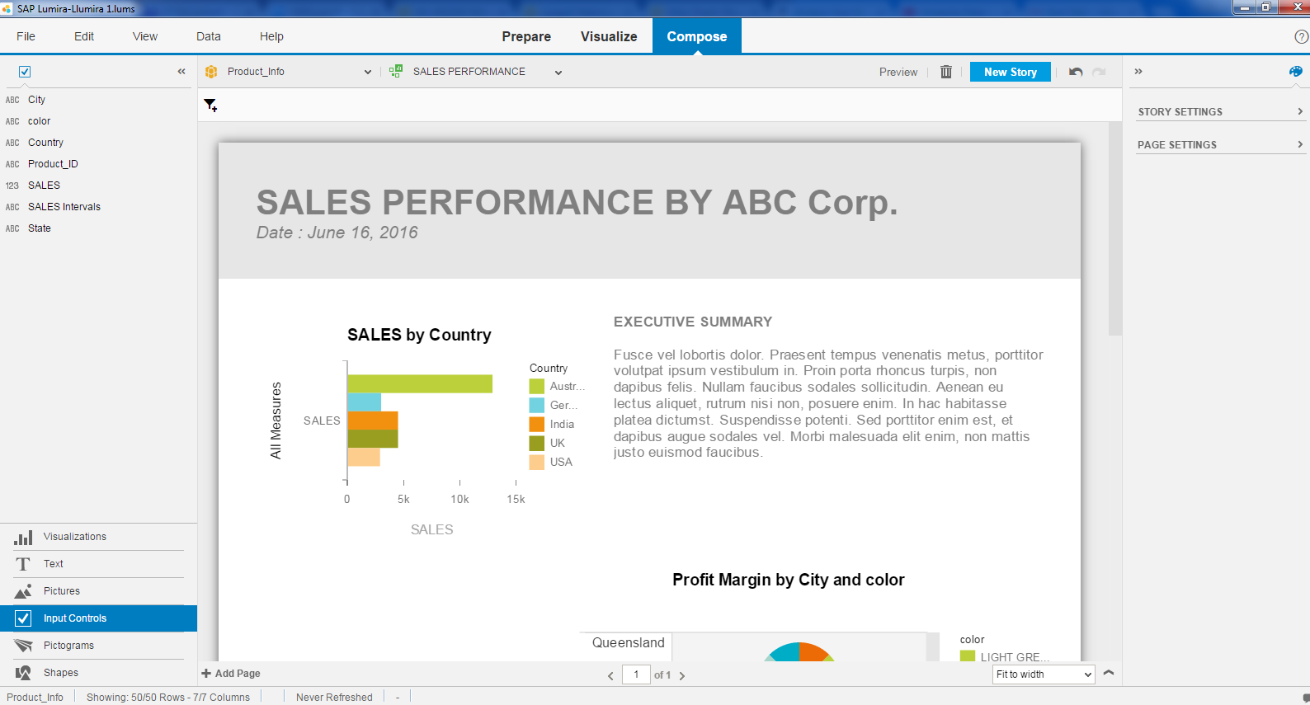
Can be created high level reporting.

Slide 4
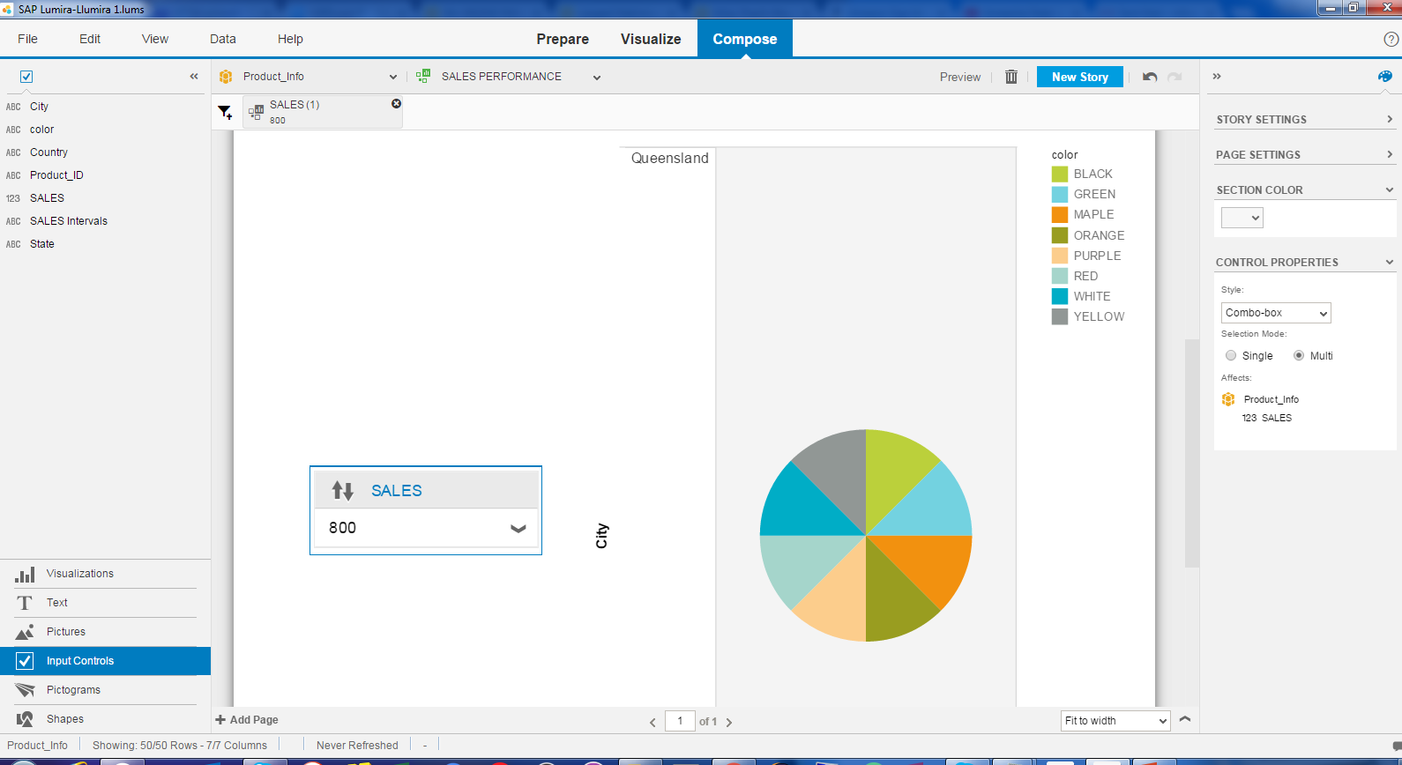
You can add input control to get detailed info of a particular region.

Slide 5
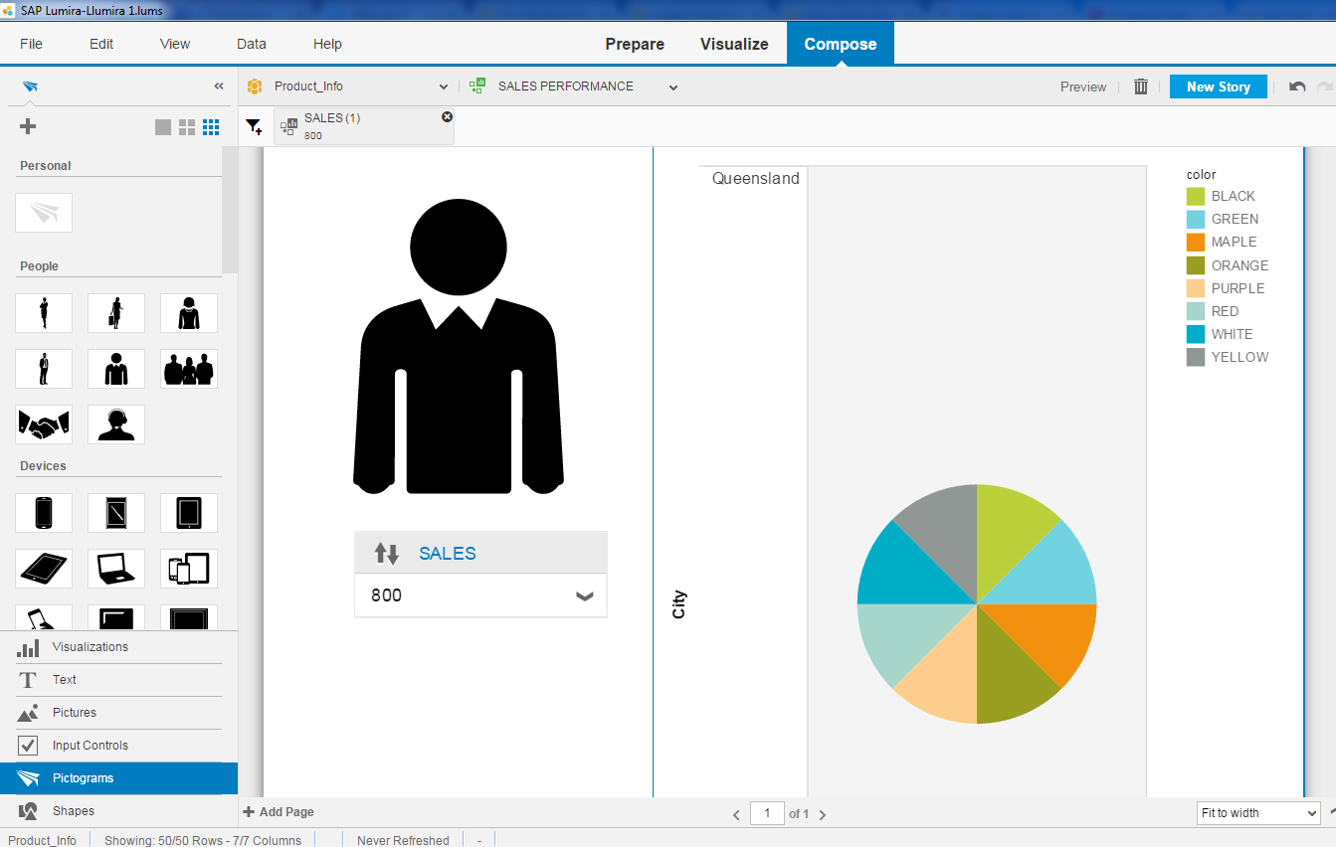
Also, pictograph can be added.

Slide 6
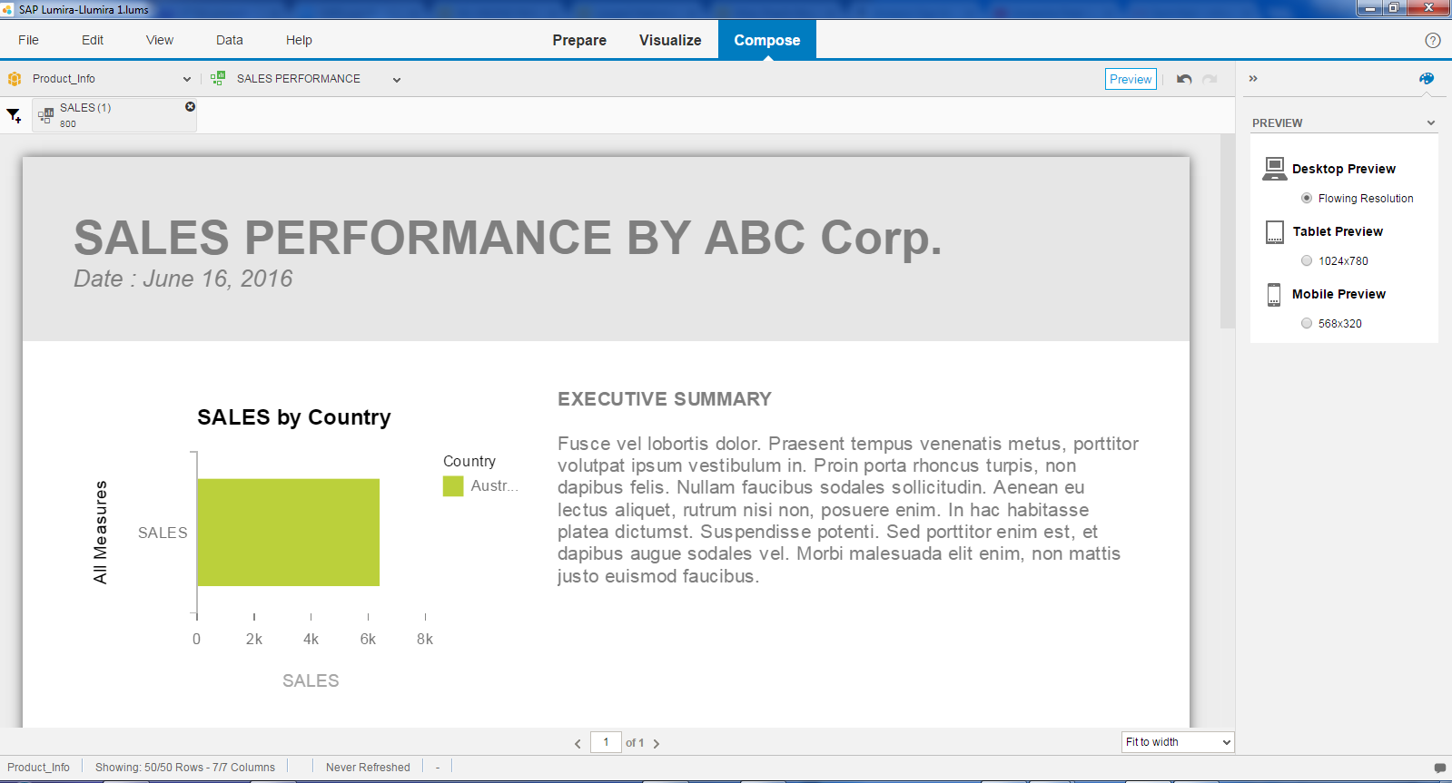
Check the preview and save.

Slide 7
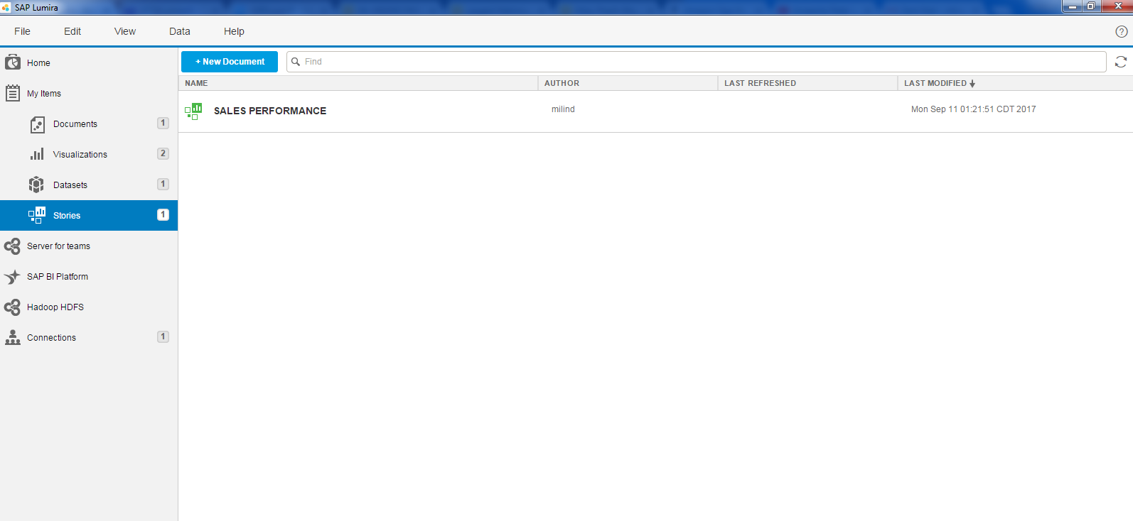
Listed under my items.

